Slide 1
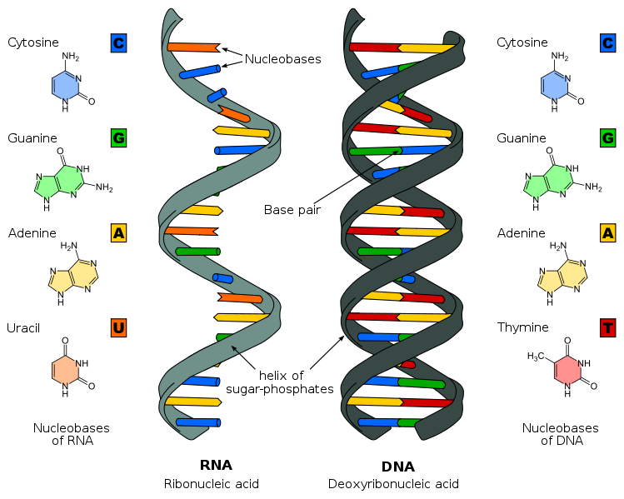
The Structure of DNA
DNA and RNA
are nucleic acids An important macromolecule in organisms that stores and carries genetic information

Slide 2
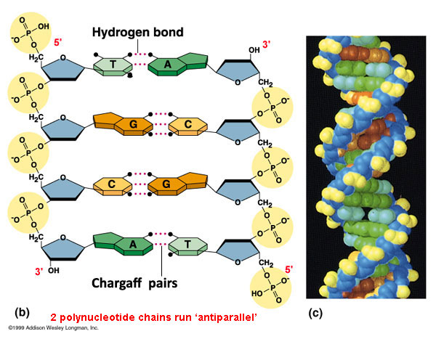
We know:
DNA is the hereditary material
DNA has a double helix structure Made of four bases; A,T,C,G Sugar-Phosphate backbone
DNA replication is semi-conservative

Slide 3
Friedrich Miescher
1871
Isolates a type of acid
From white blood cells of bandages
Coins the term Nucleic Acid – because it was found in the Nucleus of the cell
Most people thought proteins were hereditary material, so no one cared.

Slide 4
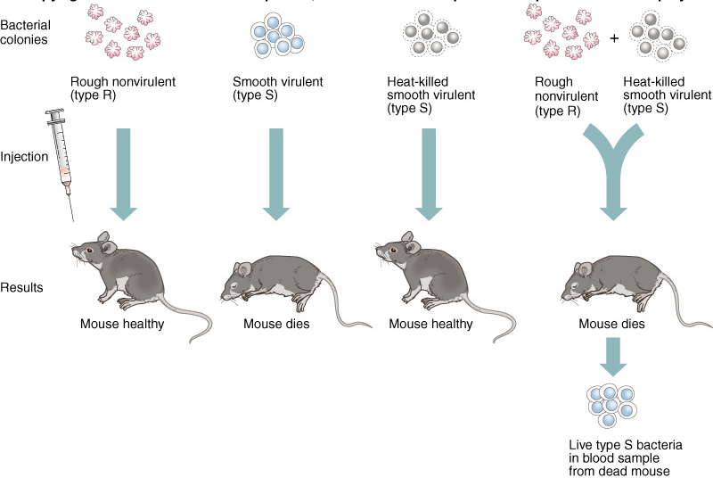
Frederick Griffith
1928
Transforming factor in bacteria

Slide 5
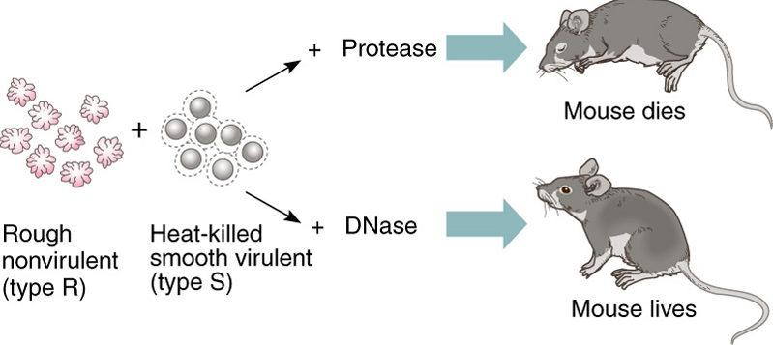
Avery, MacLeod, McCarty
1944
DNase vs. Protease

Slide 6
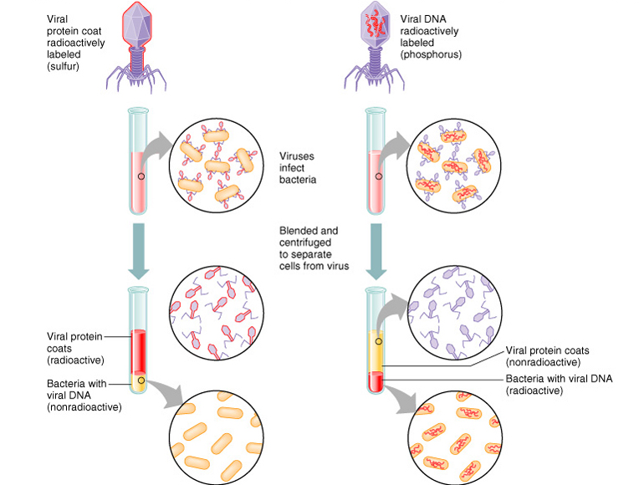
Hershey and Chase
1952
Blender
Experiment

Slide 7
By 1950’s
DNA was the hereditary molecule
Protein was not
DNA had transforming ability
Scientists began examining DNA’s structure

Slide 8
Erwin Chargaff
1950
Found that strands were always same distance apart
Also, that the amount of A always the same as amount of T
Amount of G always same as amount of C
Therefore:Purines must always bind Pyrimidines
A binds to T; G binds to C

Slide 9
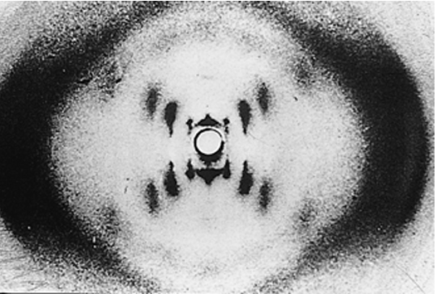
Rosalind Franklin
1953
Crystallized DNA and X-ray diffraction
From picture it was clear that DNA was in a helix With symmetrically organized bases in center

Slide 10
Watson and Crick
April 25th, 1953
Seen Franklin’s picture:
Assumed Sugar-Phosphate backbone
Chargaff’s rule:
A&T, G&C must bind each other
Determined turning radius of beta-Helix
Realized it must be two complementary strands because of base pairing
Determined it was a double Helix

Slide 11
Summary of DNA
String of Nucleotides
deoxyribose Sugar-Phosphate backbone
4 Bases:
A, G are Pyrimidines
T, C are Purines
A = T
G = C
Two complementary strands (double helix)

Slide 12
Structures of Bases
Pyrimidines
O
NH2
O
CH3
N
N
N
O
O
O
N
N
N
T
U
C
NH2
O
Purines
N
N
N
N
N
N
N
NH2
N
A
G

Slide 13
DNA Replication
Makes logical sense how DNA replication happens:
DNA has two strands with identical information
Must open up
Exposing unpaired bases
Bases are matched perfectly (compliment)
Forming two double helixes from one

Slide 14
Three Theories:
Semi-conservative
The one Watson and Crick just suggested
Strands split
New strand forms from reading other
Conservative
Makes copy of double strand, from double strand (without splitting)
Dispersive
Double helix breaking and reforming at random

Slide 15
Meselson and Stahl
1957
Density Shift Experiments
Labeled DNA with “heavy” Nitrogen
Follow label:
Does it split equally = Semi-conservative
Does it stay together = Conservative
Does it split randomly = Dispersive

Slide 16
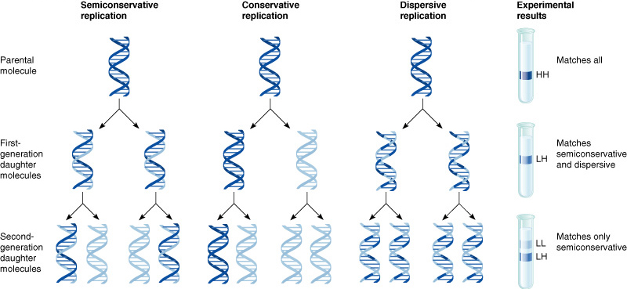
Meselson and Stahl
Insert figure 9.13

Slide 17
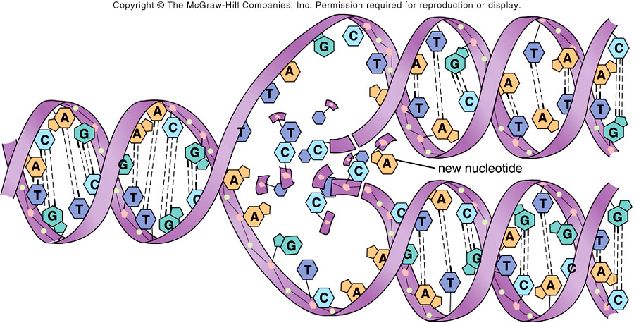
DNA Replication
The copying of DNA is remarkable in its speed and accuracy
Involves unwinding the double helix and synthesizing two new strands.
More than a dozen enzymes and other proteins participate in DNA replication
The replication of a DNA molecule begins at special sites called origins of replication, where the two strands are separated

Slide 18
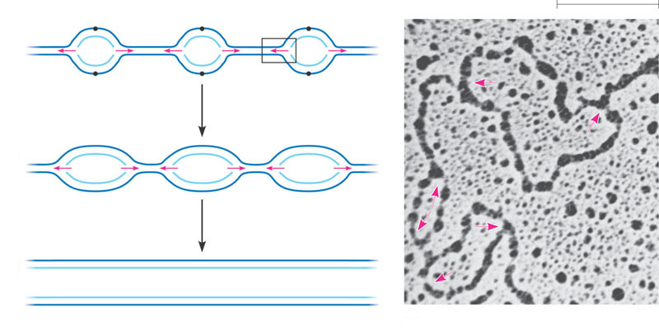
Origins of Replication
A eukaryotic chromosome may have hundreds or even thousands of replication origins
Origin of replication
Parental (template) strand
0.25 µm
Daughter (new) strand
1
Replication begins at specific sites
where the two parental strands
separate and form replication
bubbles.
Bubble
Replication fork
2
The bubbles expand laterally, as
DNA replication proceeds in both
directions.
3
Eventually, the replication
bubbles fuse, and synthesis of
the daughter strands is
complete.
Two daughter DNA molecules
(a)
In eukaryotes, DNA replication begins at many sites along the giant
DNA molecule of each chromosome.
(b)
In this micrograph, three replication
bubbles are visible along the DNA of
a cultured Chinese hamster cell (TEM).

Slide 19
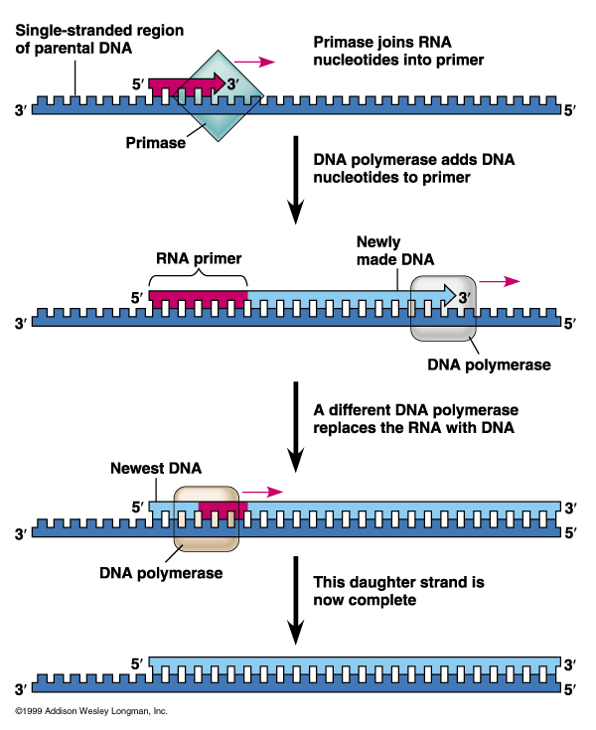
Mechanism of DNA Replication
DNA replication is catalyzed by DNA polymerase which needs an RNA primer
RNA primase synthesizes primer on DNA strand
DNA polymerase adds nucleotides to the 3’ end of the growing strand

Slide 20
Mechanism of DNA Replication
Nucleotides are added by complementary base pairing with the template strand
The substrates, deoxyribonucleoside triphosphates, are hydrolyzed as added, releasing energy for DNA synthesis.

Slide 21
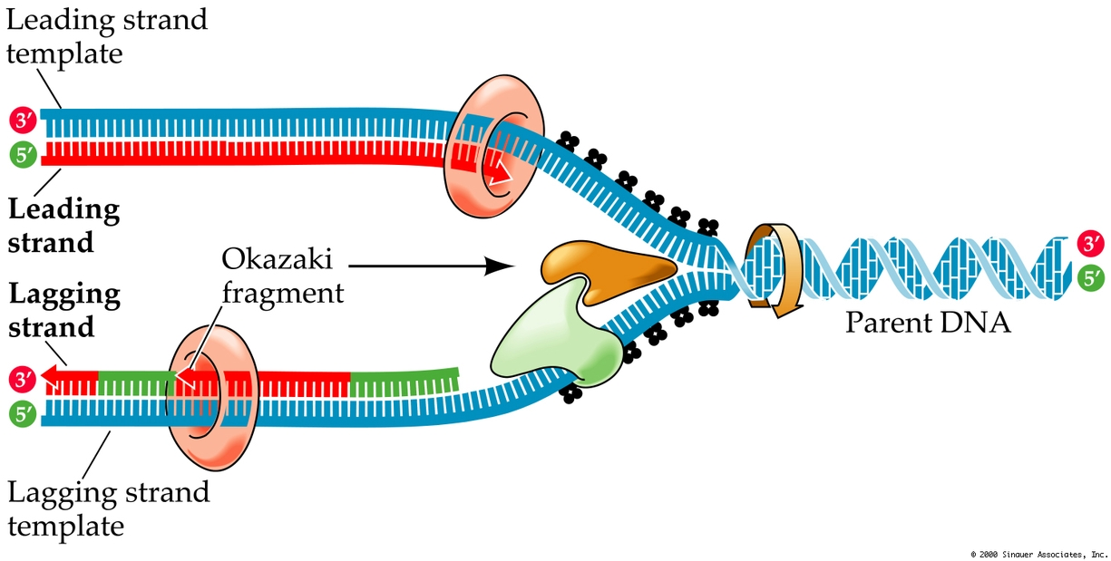
The Mechanism of DNA Replication
DNA synthesis on the leading strand is continuous
The lagging strand grows the same general direction as the leading strand (in the same direction as the Replication Fork). However, DNA is made in the 5’-to-3’ direction
Therefore, DNA synthesis on the lagging strand is discontinuous
DNA is added as short fragments (Okasaki fragments) that are subsequently ligated together

Slide 22
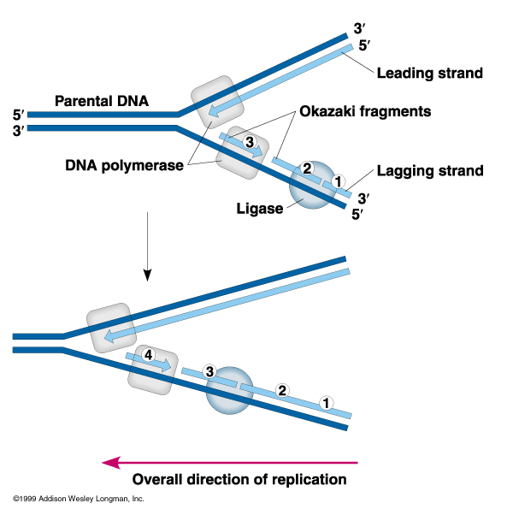

Slide 24
Enzymes in DNA replication
Helicase unwinds
parental double helix
Binding proteins
stabilize separate
strands
Primase adds
short primer
to template strand
DNA polymerase III
binds nucleotides
to form new strands
DNA polymerase I (Exonuclease) removes RNA primer and inserts the correct bases
Ligase joins Okazaki
fragments and seals
other nicks in sugar-phosphate backbone

Slide 25
Replication
3’
3’
5’
5’
3’
5’
3’
5’
Helicase protein binds to DNA sequences called
origins and unwinds DNA strands.
Binding proteins prevent single strands from rewinding.
Primase protein makes a short segment of RNA
complementary to the DNA, a primer.

Slide 26
Replication
Overall direction
of replication
3’
3’
5’
5’
3’
5’
3’
5’
DNA polymerase enzyme adds DNA nucleotides
to the RNA primer.

Slide 27
Replication
Overall direction
of replication
3’
3’
5’
5’
3’
5’
3’
5’
DNA polymerase enzyme adds DNA nucleotides
to the RNA primer.
DNA polymerase proofreads bases added and
replaces incorrect nucleotides.

Slide 28
Replication
Overall direction
of replication
3’
3’
5’
5’
3’
5’
3’
5’
Leading strand synthesis continues in a
5’ to 3’ direction.

Slide 29
Replication
Overall direction
of replication
3’
3’
5’
5’
Okazaki fragment
3’
5’
3’
5’
3’
5’
Leading strand synthesis continues in a
5’ to 3’ direction.
Discontinuous synthesis produces 5’ to 3’ DNA
segments called Okazaki fragments.

Slide 30
Replication
Overall direction
of replication
3’
3’
5’
5’
Okazaki fragment
3’
5’
3’
5’
3’
5’
Leading strand synthesis continues in a
5’ to 3’ direction.
Discontinuous synthesis produces 5’ to 3’ DNA
segments called Okazaki fragments.

Slide 31
Replication
3’
3’
5’
5’
3’
5’
3’
3’
3’
5’
5’
5’
Leading strand synthesis continues in a
5’ to 3’ direction.
Discontinuous synthesis produces 5’ to 3’ DNA
segments called Okazaki fragments.

Slide 32
Replication
3’
3’
5’
5’
3’
5’
3’
3’
3’
5’
5’
5’
Leading strand synthesis continues in a
5’ to 3’ direction.
Discontinuous synthesis produces 5’ to 3’ DNA
segments called Okazaki fragments.

Slide 33
Replication
3’
3’
5’
5’
3’
5’
3’
3’
3’
5’
5’
5’
Exonuclease activity of DNA polymerase I removes RNA primers.

Slide 34
Replication
3’
3’
5’
3’
5’
3’
3’
5’
5’
Polymerase activity of DNA polymerase I fills the gaps.
Ligase forms bonds between sugar-phosphate backbone.

Slide 35
Replication Fork Overview

